Slide 1


CANARA ENGINEERING COLLEGE
Sudhindra Nagara, Benjanapadavu, Mangalore– 574219, D.K Karnataka
DEPARTMENT OF COMPUTER SCIENCE AND ENGINEERING
AI-Powered Cognitive Map for Enhanced Learning
Team ID:CEC/CSE/2026-27/P-51
Name USN: Tharini 4CB23CS171,
Sookta 4CB23CS156,
Sneha 4CB23CS155.
Under the guidance of
Ms. Bhavana D
Assistant Professor, CS&E

Slide 2
Table of Contents:
Introduction
Literature Survey
Research Gap
Problem Statement
Objectives
Scope
Requirement
Methodology
Expected Results

Slide 3
Introduction
In today’s academic environment, students often struggle with large volumes of study material, limited doubt-clarification, and tools that do not adapt to their individual learning pace. While AI is rapidly transforming the education sector, many existing platforms still rely on static content and fail to offer real-time personalization or meaningful guidance. This project addresses these challenges by developing an AI-powered system that analyzes academic materials, extracts key concepts, and presents them as interactive visual maps. Along with instant explanations, personalized support, and intelligent feedback, the system aims to help students learn more effectively, confidently, and efficiently.

Slide 4
Literature Survey
Author/Year | Study/Work | Method Used | Key Result | Limitation
1. Jonathan Schuster et.al,2025 | Learning Maps as Cognitive Models for Instruction and Assessment | Research synthesis and cognitive modeling | Validated and effective for instruction | Complex and hard to implement
2. Khanyisile Twabu,2025 | Enhancing the cognitive load theory and multimedia learning framework with AI insight | Conceptual framework integrating AI + CLT + CTML | Proposed AI-enhanced model for personalised learning | No empirical testing, purely theoretical
3. Joe Barrow et.al,2024 | PDFTriage: Question Answering over Long, Structured Documents | Structured document retrieval using PDF metadata and LLM-based triage | Improved accuracy and readability in question answering over long, structured PDFs compared to retrieval baselines. | Lack of empirical testing on larger, diverse datasets.

Slide 5
Author/Year | Study/Work | Method Used | Key Result | Limitation
4. YASHAR DELDJOO et.al,2024 | Interactive Question Answering Systems. | Literature review and taxonomy of interactive question answering (IQA) architectures. | Defined unified framework combining QA, dialogue, and multimodal interaction. | Lacks empirical implementation and performance evaluation.
5. Siwen Luo et.al,2023 | PDF-VQA: A New Dataset for Real-World VQA on PDF Documents | Graph-based model with hierarchical dataset creation. | Out performed baselines in document understanding and multi-page VQA tasks. | Limited dataset coverage and complex model structure.
6. Wei Wei et.al,2023 | AttenWalker: Unsupervised Long-Document Question Answering via Attention-based Graph Walking | Synthetic QA generation + LED model | Effective QA on long documents without supervision | Synthetic data may not match real QA distribution

Slide 6
Author/Year | Study/Work | Method Used | Key Result | Limitation
7. Antoun Yaacoubet.al, 2023 | Assessing AI-Generated Questions’ Alignment with Cognitive Frameworks in Educational Assessment. | AI Q-gen, ML (LR, NB, SVC), DistilBERT, Bloom’s Taxonomy. | DistilBERT 91%, simple models → low levels, struggle higher. | Higher-order hard, domain-limited, prompt-dependent.
8. Jawad Alshboul et.al,2022 | A Review of Automatic Question Generation in Teaching and Learning | Systematic literature review of AQG for programming education | Identified dominant methods and gaps in feedback generation | Under-reporting of non-English studies and omitted full-text papers
9. Yong Yu et.al,2020 | A Graph-based Interaction Model for Knowledge Tracing | GCN + LSTM + Attention + History Recap. | +1% AUC, better prediction & long-term tracking. | Needs big data, high compute, no feedback/explanation.

Slide 7
Author/Year | Study/Work | Method Used | Key Result | Limitation
10. Zifu Shi et.al,2020 | Construction of Cognitive Maps to Improve Reading Performance | Experimental reading + signaling (physical/verbal) on paper vs screen | Signaling boosts navigation & comprehension, especially physical cues on screen | Limited participant diversity; short texts & behavioral measures only

Slide 8
Research Gap:
Lack of Integrated Learning Systems – Most existing AI-based platforms focus either on content explanation or quizzes, but very few integrate explanation, doubt clarification, quizzes, and corrective feedback into one unified system.
Limited Error Feedback Mechanisms – Current systems often provide the correct answer but fail to give detailed reasoning or explain misconceptions, which is crucial for deep learning and concept retention.
Insufficient Personalization – While intelligent tutoring systems exist, many do not adapt cognitive maps or learning paths based on individual learner performance, styles, or weak areas.

Slide 9
Problem Statement:
Students lack in tools that explain study material, clear doubts instantly, and give feedback on mistakes. Students lack an interactive system that can instantly clarify doubts and generate personalized quizzes from their own study materials.

Slide 10
Objectives
To provide instant doubt clarification using AI
To create customized quizzes based on learner weaknesses
To offer real-time feedback on mistakes with explanations

Slide 11
scope
Development of an AI system that processes students’ own study materials.
Real-time doubt clarification and concept explanation.
Generation of personalized quizzes and feedback.

Slide 12
Requirements
Programming Language: TypeScript and JavaScript
Backend: Supabase (PostgreSQL+Authentication+APIs)
Frontend: HTML,Tailwind CSS,React(with Vite)

Slide 13
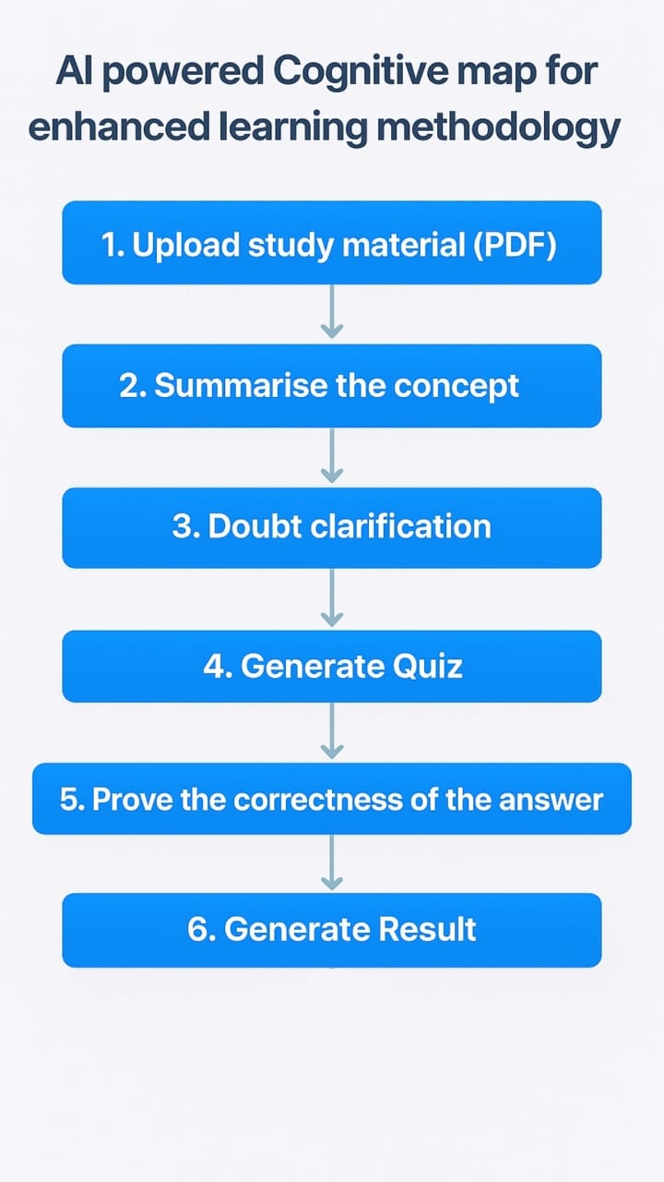

Slide 14
Expected Results
The system can extract and understand content from uploaded PDF study materials.
Students receive accurate, context-based answers to their doubts.
The generated quizzes help test understanding of key concepts.
Wrong answers are followed by correct solutions and clear explanations.
The platform promotes better learning, improved clarity, and higher retention.

Slide 15
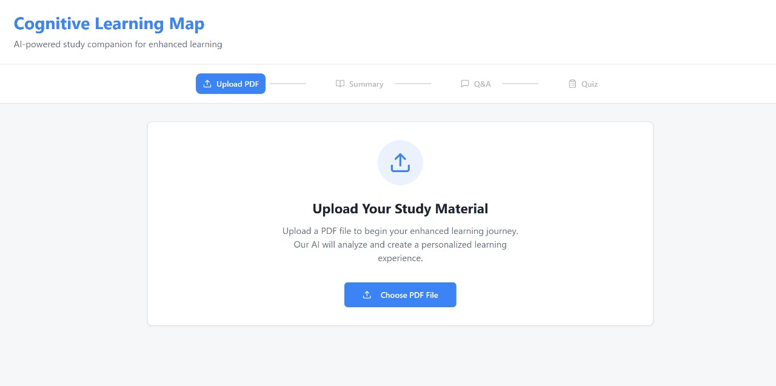
Result

Slide 16
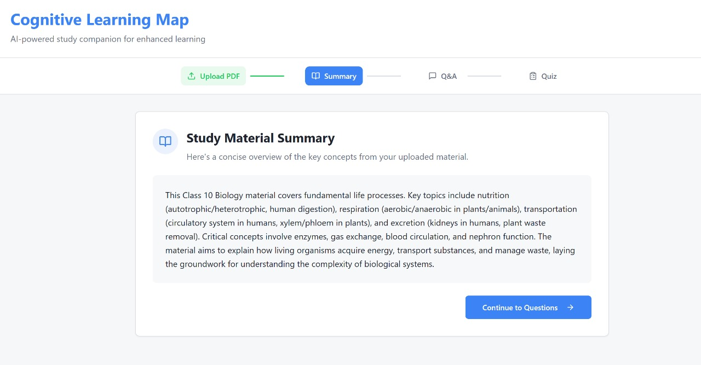

Slide 17
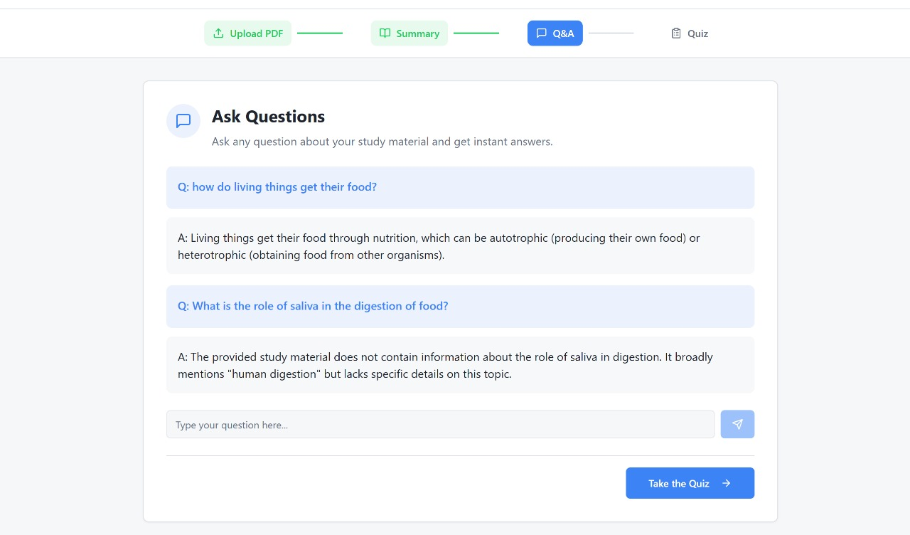

Slide 18
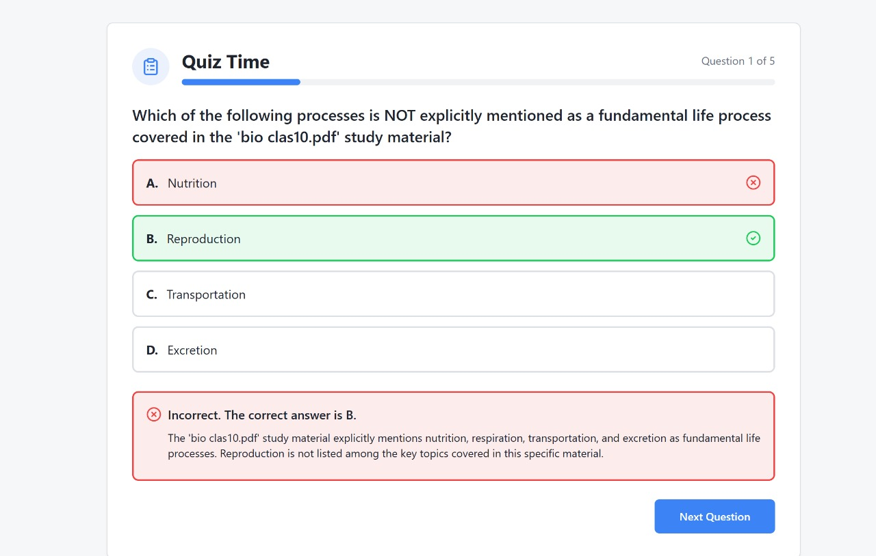

Slide 19
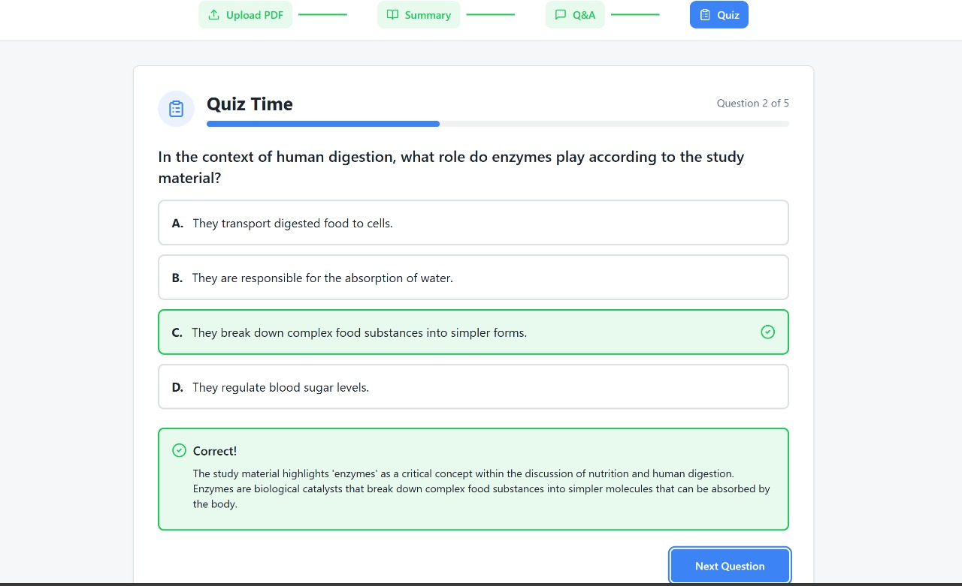

Slide 20
